Slide 1
Multi-sports at Thomas Wolsey OA
A resource bank of activities of teachers

Slide 2
BOCCIA AT TWOA
A resource bank of activities of teachers

Slide 3
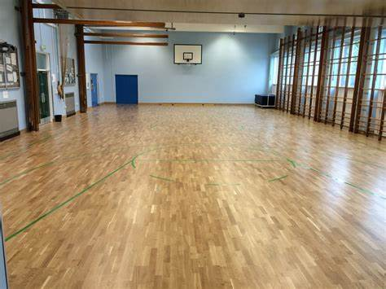
Outline of Drill:
Boccia Aiming 1
We set up a coned grid.
Pupils are placed around the outside of the grid- they are each given 2 balls of the same colour.
The lead adult places the white ball (the jack) into the centre of the grid.
Pupils are asked to throw the ball one at a time towards the jack.
The pupil closest to the jack wins a point for their team (red or blue).
The activity does not have to be competitive.
Key coaching points:
Use the specific terminology.
Use a ramp where applicable.
Encourage pupils to change the weight and direction of their throw.

Slide 4
Outline of Drill:
Boccia Aiming 3
We set up a coned grid.
Pupils are placed around the outside of the grid- they are each given 2 balls of the same colour.
The lead adult places a skittle in the centre of the grid.
Pupils are asked to throw the ball one at a time towards the skittle, trying to knock it over.
Everytime a skittle gets knocked down the pupil wins a point for their team (red or blue).
The activity does not have to be competitive.
Key coaching points:
Use the specific terminology.
Use a ramp where applicable.
Encourage pupils to change the weight and direction of their throw.

Slide 5
Outline of Drill:
Boccia Aiming 2
We set up a coned grid.
Pupils are placed around the outside of the grid- they are each given 2 balls of the same colour.
The lead adult sets up a triangle of cones in the centre of the grid.
Pupils are asked to throw the ball one at a time, trying to make the ball land in the centre of the triangle.
If the ball lands in the triangle then the pupil wins a point for their team (red or blue).
The activity does not have to be competitive.
Key coaching points:
Use the specific terminology.
Use a ramp where applicable.
Encourage pupils to change the weight and direction of their throw.

Slide 6
Outline of Drill:
Boccia Game
The Rules
· 6 players per match, 3 from each team.
· One team has the blue balls, the other has the red balls
· Players sit on alternate seats i.e.
Red, Blue, Red, Blue, Red, Blue
· Each player has 2 balls.
· The first player throws the white ball onto the court
· They then throw their colour as close to the white as possible
· Going down the line, each player has their throw. Repeat for both balls to be thrown by each player.
· Closest colour to the white wins a point. Can score multiple points if more than one ball is closer than any of the opposing colour.
· Repeat with the 2nd player in the line throwing the white ball.
· Match ends after 6 rounds. (this can be shortened if both sides agree)

Slide 7
NEW AGE KURLING AT TWOA
A resource bank of activities of teachers

Slide 8
Outline of Drill:
Stone Aiming:
We set up a coned grid.
Create a taped or coned area within the centre of the grid and place a curling stone in the middle of it.
Pupils are asked to roll the curling stone towards the grid. The aim is to knock the curling stone out of the square with their own stone.
The activity does not have to be competitive.
Key coaching points:
Use the specific terminology.
Use a ramp where applicable.
Encourage pupils to change the weight and direction of their roll.

Slide 9
Outline of Drill:
Stone Spinning:
We set up a coned grid.
Pupils can find a space within the grid.
Pupils are asked to spin the curling stone as hard as they can.
For every second that the stone spins, they win a point.
The activity does not have to be competitive.
Key coaching points:
Use the specific terminology.
Use a ramp where applicable.
Encourage pupils to spin the stone and not roll it.

Slide 10
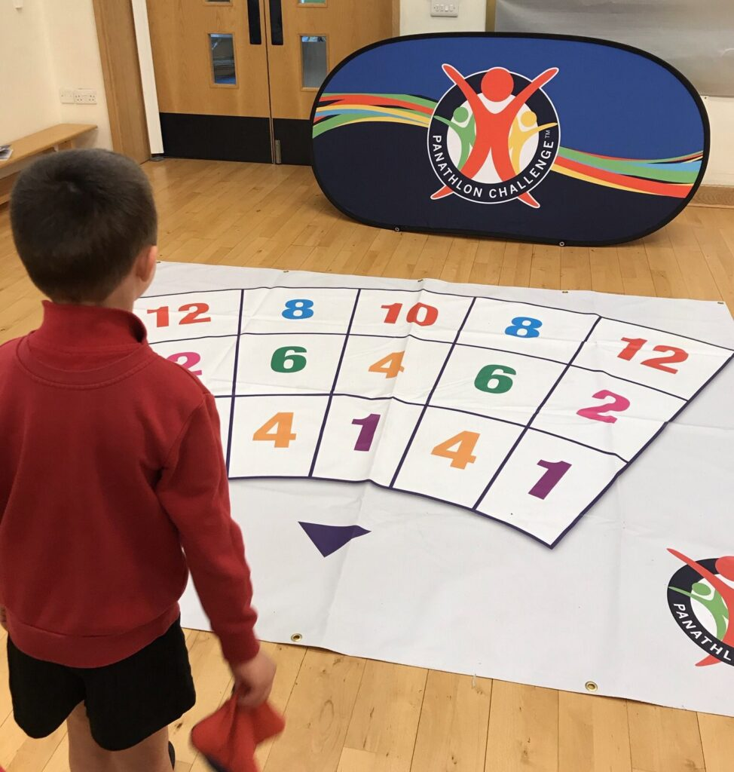
Outline of Drill:
Bean bag throw:
Place down a Panathlon mat.
Pupils can throw their bean bag towards the mat.
Whatever number they land on is the number of points they get.
The activity does not have to be competitive.
Key coaching points:
Use the specific terminology.
Use a ramp where applicable.
Encourage pupils to spin the stone and not roll it.

Slide 11
Outline of Drill:
New Age Kurling game:
We set up a coned grid.
Lead adult places the stone within the grid.
Pupils are asked to roll the curling stone towards the white stone. The aim is to get as close as they can to this stone.
The activity does not have to be competitive.
Key coaching points:
Use the specific terminology.
Use a ramp where applicable.
Encourage pupils to change the weight and direction of their roll.

Slide 12
TABLE CRICKET AT TWOA
A resource bank of activities of teachers

Slide 13
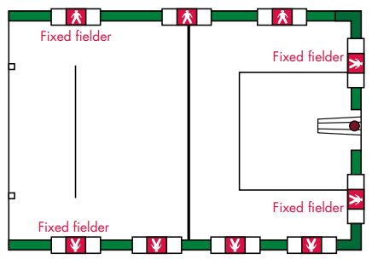
How to play Table Cricket:
A full guide for setting up, playing and scoring a game of Table Cricket has been provided by the Lord Taverners.
Please refer to the guide: guide-to-table-cricket.pdf (lordstaverners.org)
Key coaching points:
Use the specific terminology.
Use a ramp where applicable.
Encourage pupils to change the weight and direction of their roll.

Slide 14
BOWLING AT TWOA
A resource bank of activities of teachers

Slide 15
Outline of Drill:
Coned Bowling:
We set up a coned grid.
At the end of the grid set up some cones within a bowling pin formation.
Encourage pupils, one at a time, to bowl towards the cones.
Each pupil has two goes and the number of cones knocked over is the number of points they get./
Key coaching points:
Use the specific terminology.
Use a ramp where applicable.
Encourage pupils to change the weight and direction of their roll.

Slide 16
Outline of Drill:
10 PIN Bowling:
We set up a coned grid.
At the end of the grid set up some bowling pins.
Encourage pupils, one at a time, to bowl towards the pins.
Each pupil has two goes and the number of cones knocked over is the number of points they get.
Key coaching points:
Use the specific terminology.
Use a ramp where applicable.
Encourage pupils to change the weight and direction of their roll.

